Slide 1
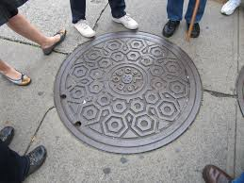




Water and Sewer Rate Study Overview and Preliminary Discussions
November 22, 2021

Slide 2

Purpose of the Presentation
Provide the Council with an overview of the rate study process
Gain Council feedback on the preliminary study analysis
  Capital funding approach
  Revenue adjustments needs
Gain Council input on cost of service and rate
design analyses
Discuss study next steps and schedule
2

Slide 3
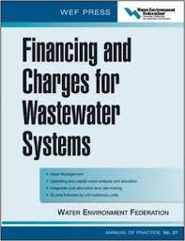

Purpose of the Rate Study
Provides sufficient revenue to operate and maintain City’s water and sewer infrastructure
Develop equitable, proportional, and cost-based water and sewer rates
  Meet the requirements of Proposition 218
Develop the study using generally accepted methodologies
  Tailored to the City’s systems and customer characteristics
Reflect prudent financial planning criteria
  Adequate rate funding of capital projects
  Meet target reserve ending balances
  Maintain legally required debt service coverage
  ratios
Last water and sewer rate adjustment was in 2015
3

Slide 4
Overview of Proposition 218
Provides the requirement for setting and implementing property related rates and fees
  California constitution Article XIII D
Requires a cost basis for establishing the level of the rates
  “Fees shall not exceed the reasonable cost of providing the service”
  “Fees shall not exceed the proportional cost of providing the service attributable to the parcel which it is imposed”
Requires a customer notification process and protest hearing
  If 50% + 1 protest, the Council can not implement rate adjustments
  Proposed rates are the maximum rates that can be charged for the specified time period
  Council may reduce rates lower than noticed levels
4

Slide 5
Establishing Cost-Based Water and Sewer Rates
Revenue Requirement
Compares the revenue of the utility to the expenses to evaluate the level of overall rate revenues
Cost of Service
Proportionally distributed the revenue requirement between the various customer classes of service
Rate Design
Design rates for each class of service to meet the revenue needs of the utility, along with the cost of service proportional distribution of costs
5

Slide 6

Revenue Requirement

Slide 7
Overview of the Revenue Requirement
Compares utility revenues to expenses
Determines the level of revenue (rate) adjustment necessary
Reviews a specific time period
Five-year rate schedule; ten-year financial plan
Utility is analyzed on a “stand-alone basis”
Utilizes the “cash basis” methodology
No transfer of funds from other City funds
Rates support each utility’s operations and capital
Generally accepted method for municipal utilities
Uses prudent financial planning criteria
Maintaining sufficient ending reserve balances
Attaining target debt service coverage (DSC) ratio
7

Slide 8

Revenue Requirement Key Assumptions
Developed a projection of water and sewer rate revenues
  Based on current adopted rates and recent customer characteristics
O&M projections are based on the 2021/22 adopted budget
  Projected over the 10-year period using historical inflationary factors
Capital funding analysis is based on current capital
plans
  Includes long-term borrowing to fund capital needs
  Includes funding from annual rate funded capital
  and available reserves
Meet target financial planning metrics
  Target ending reserve levels (operating and capital
  funds)
  Maintain adequate debt service coverage ratio

Slide 9
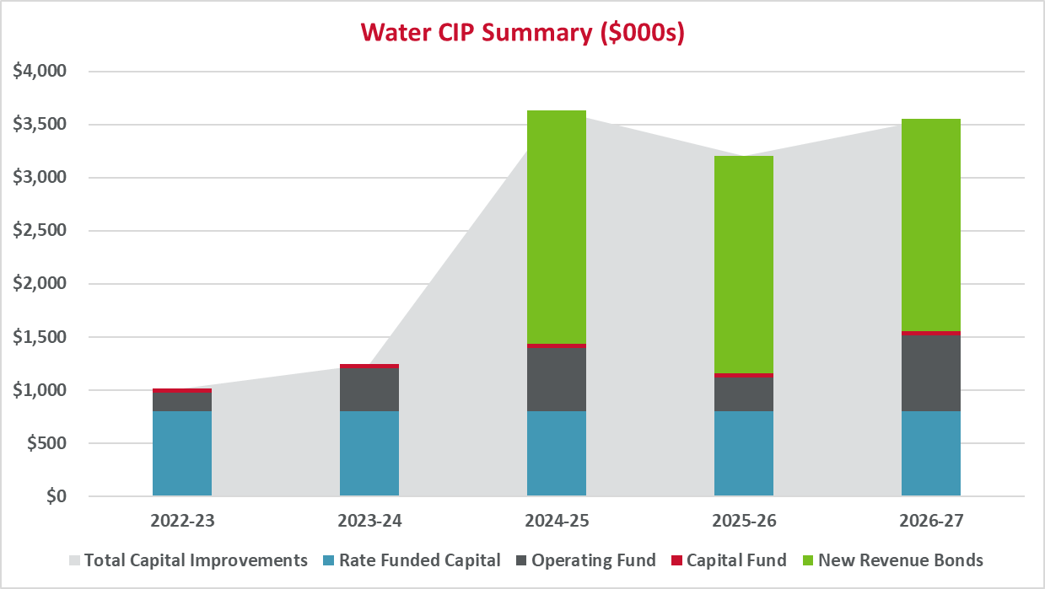
Preliminary Water Capital Funding Plan
Capital funding plan reflects adopted capital improvement plan. Major capital improvement projects include annual waterline replacement program, river wells project, and reservoir 1 expansion
9

Slide 10
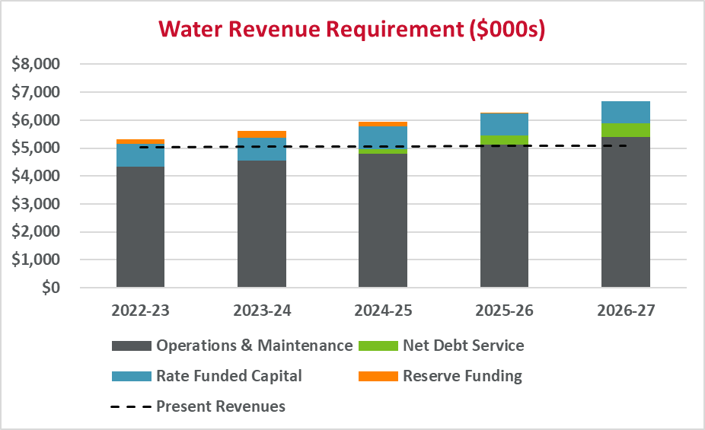
Preliminary Water Revenue Requirement
10

Slide 11
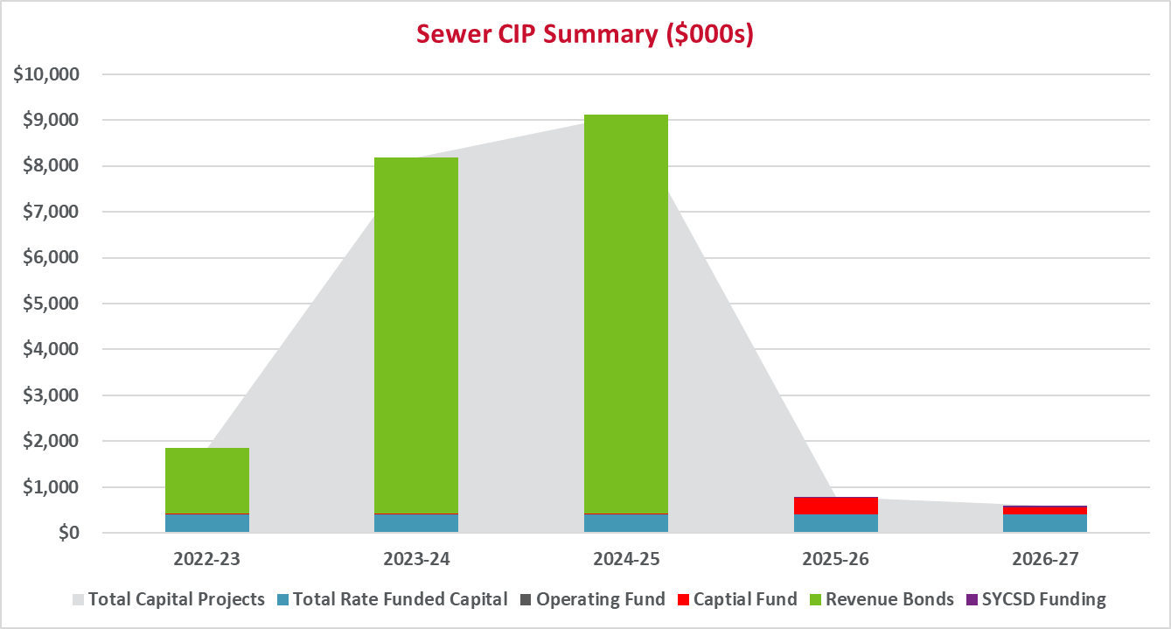
Preliminary Sewer Capital Funding Plan
Capital funding plan reflects adopted capital improvement plan. Major capital improvement projects include annual sewer line replacement program, lift station upgrades, WWTP Quality Project, and manhole rehabilitation
11

Slide 12
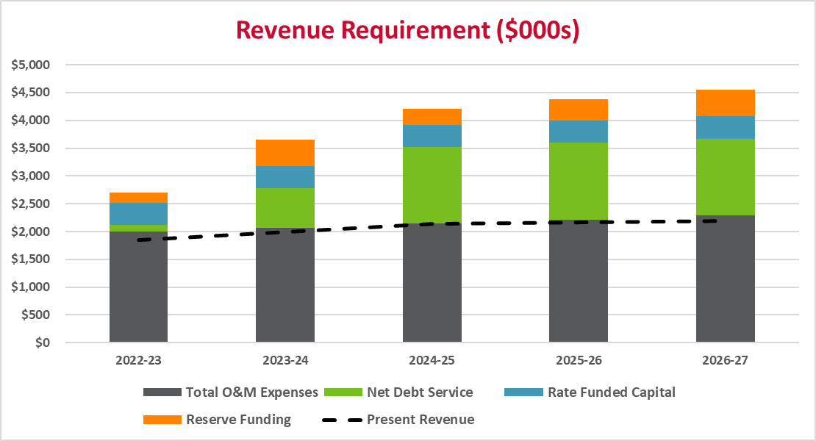
Preliminary Sewer Revenue Requirement
12

Slide 13
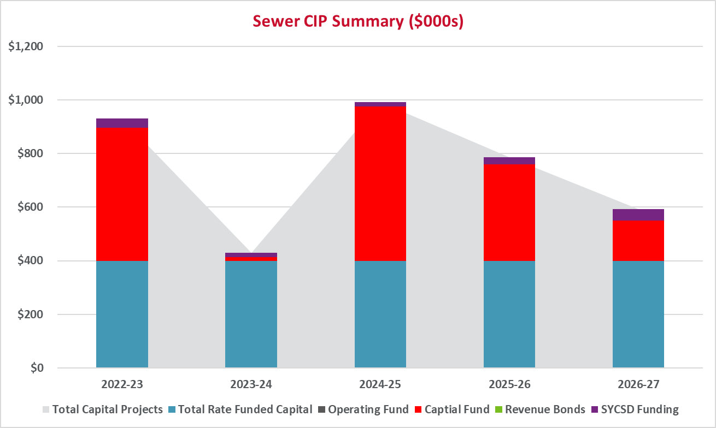
Preliminary Sewer Capital Funding Plan (Alternative)
Capital funding plan reflects adopted capital improvement plan. Excludes WWTP Quality Project
13

Slide 14
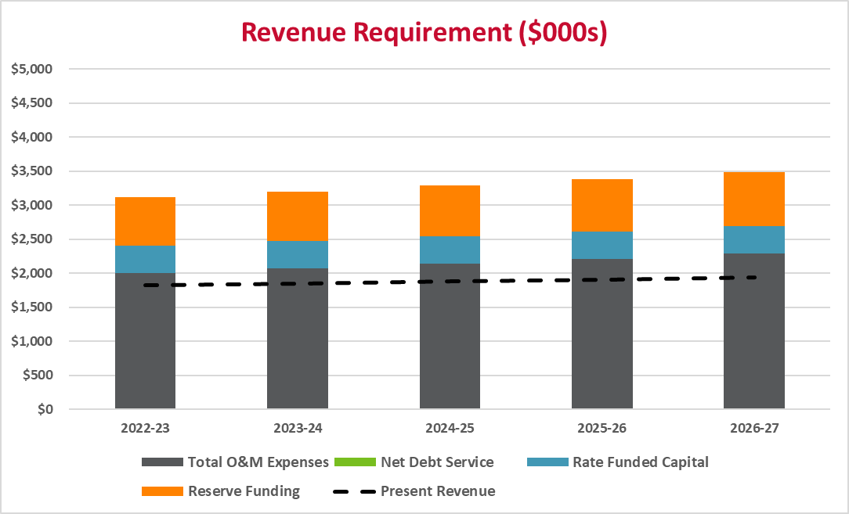
Preliminary Sewer Revenue Requirement (Alternative)
14

Slide 15
Preliminary Example Residential Monthly Revenue / Rate Adjustments
 | 2021-22 | 2022-23 | 2023-24 | 2024-25 | 2025-26 | 2026-27
Water
Avg Customer Bill¹ | $127.18 | $134.17 | $141.55 | $149.34 | $157.55 | $166.22
Monthly Change |  | 6.99 | 7.38 | 7.79 | 8.21 | 8.67
Sewer
Avg Customer Bill | $34.65 | $55.44 | $74.84 | $84.20 | $87.57 | $90.63
Monthly Change |  | 20.79 | 19.40 | 9.36 | 3.37 | 3.06
Sewer - Alt
Avg Customer Bill | $34.65 | $65.84 | $67.15 | $68.49 | $69.86 | $71.26
Monthly Change |  | 31.19 | 1.32 | 1.34 | 1.37 | 1.40
1] – Based on 15 CCF and 5/8” Meter at current rate structure
15

Slide 16
Revenue Requirement – Policy Discussion
Long-Term Financial Sustainability
Meeting Financial Metrics
Prudent Funding of Annual Renewal and Replacement
Levels of Service
Use of Growth Related Charges
Debt service coverage ratio
Annual depreciation expense
Projection of future O&M
Capital infrastructure needs
Target ending reserve balances
Future replacement needs
Methodology and approach
Use of long-term debt
Additional programs/practices
Capacity/expansion projects
Capacity/expansion related debt service
16

Slide 17

Cost of Service

Slide 18
Overview of the Cost of Service
What is cost of service?
Analysis to proportional distribute the revenue requirement to the customer classes of service
Why cost of service
Avoids interclass subsidies
Revenues reflect costs
Objectives of Cost of Service
Determine if subsidies exist
Develop average unit costs
Meet the proportionality requirements of Proposition 218
18

Slide 19
Generic Water Cost of Service Methodology
Residential Customers
Residential
Commodity Related
Multi-Family
Non-Residential
Source of Supply
Distribution
Pumping
Etc.
Total Expenses
Multi-Family Customers
Capacity Related
Residential
Multi-Family
Non-Residential
Customer Related
Residential
Non-Residential Customers
Multi-Family
Non-Residential
19

Slide 20
Generic Sewer Cost of Service Methodology
Residential Customers
Residential
Volume Related
Multi-Family
Non-Residential
Treatment
Collection
Pumping
Etc.
Total Expenses
Multi-Family Customers
Strength Related
Residential
Multi-Family
Non-Residential
Customer Related
Residential
Non-Residential Customers
Multi-Family
Non-Residential
20

Slide 21
Cost of Service – Policy Discussion
Rate Structure/Cost Relationships
Development of customer classes of service
Identifies interclass differences between levels of service (if present)
Implementation or transition to cost of service results (if necessary)
Wastewater volume/strength
Review of customer usage and characteristics
Separate rate schedules
Based on customer characteristics
Water average day/peak day
Customer
21

Slide 22

Rate Design

Slide 23
Overview of the Rate Design
Reflect the findings of the revenue requirement and cost of service analyses
Meet the rate design goals and objectives of the City
Produce sufficient revenues to meet the target revenues of the utility, and each class of service
Are cost-based and proportional
23

Slide 24
Typical Rate Setting Goals and Objectives
Revenue Sufficiency and Stability
Efficient Use of the Resource
Equitable and non-discriminating (cost-based)
Easy to Understand (customer)
Easy to Administer (City)
Affordability
Legally Defendable
24

Slide 25
Current Water Rate Structures
 | Present Rates
Fixed Charge
5/8" | $75.43
3/4" | 113.15
1" | 188.58
1 1/2" | 377.17
2" | 603.47
3" | 1,206.94
4" | 1,885.84
6" | 3,771.68
8” | 6,034.69
Consumption Charge
Single Family
0 – 16 ccf | $3.45
16 + ccf | 4.05
All Others | $3.75
Fixed Charge
  All customers - varies by service meter size
Consumption Charge
  Single Family – 2-tiered increase blocks
  All others (multi-family, commercial, irrigation) – uniform rate
  Evaluating three tier water rate structure for Single Family
25

Slide 26
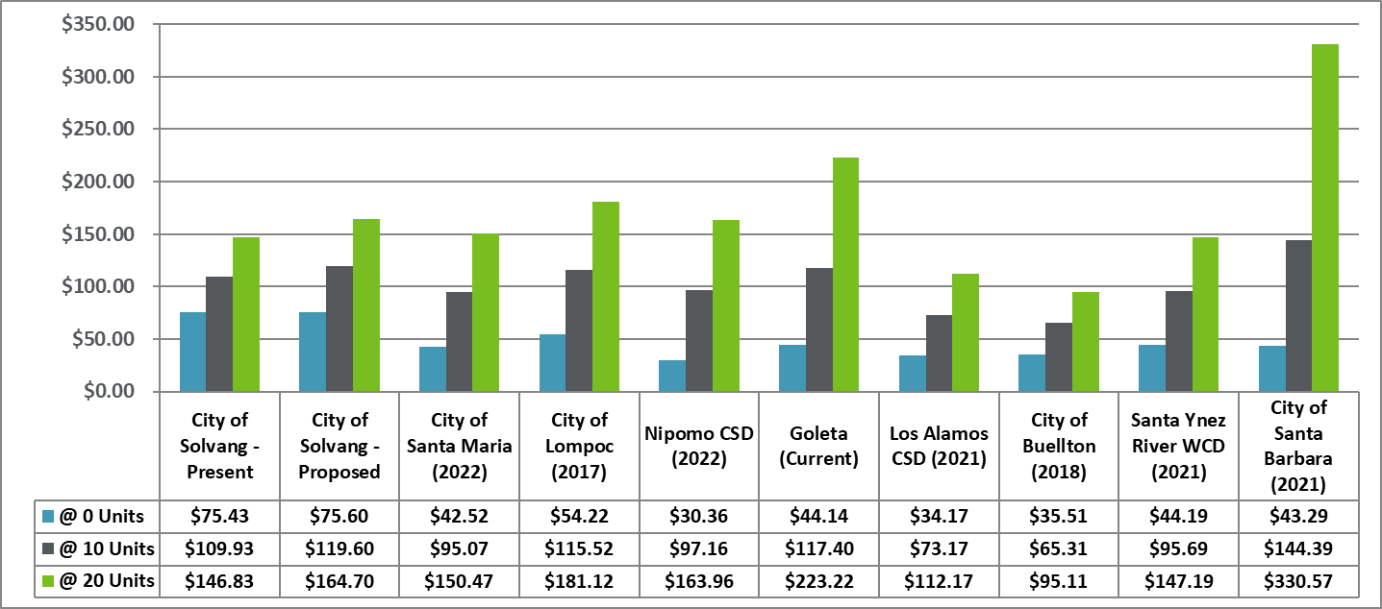
Local and Regional Residential Water Bill Comparison

Slide 27
Current Sewer Rate Structures
 | Present Rates
Fixed Charge
All Customers | $34.65
Volumetric Charge | $ / CCF
Com & Ind | $2.85
Com & Ind – High | 7.42
Fixed Charge
  All customers – flat rate
Volumetric Charge
  Single Family and Multi-Family – none
  Commercial & Industrial – uniform rate
27

Slide 28
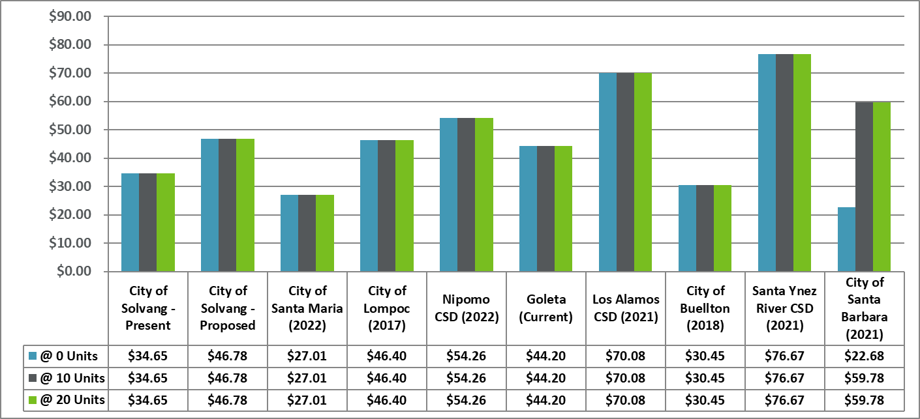
Local and Regional Residential Sewer Bill Comparison

Slide 29
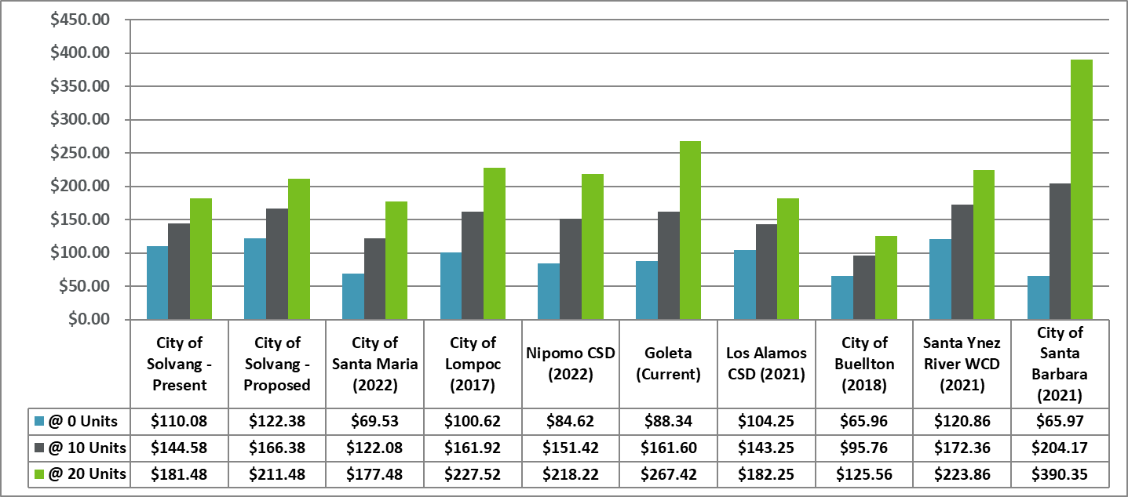
Local and Regional Residential Combined Bill Comparison

Slide 30

Next Steps and Schedule

Slide 31
Next Steps
Estimated Project Schedule
Gain Council feedback:
  Capital funding approach
  Overall revenue adjustment needs
  Customer classes of service
  Rate structure
Complete draft water and sewer rate technical analyses
Complete connection charge analysis
Review draft results with City staff
Review results and recommendations with Council
Finalize technical analyses
Present findings and proposed rates
January/February 2022: Council Workshop to review study recommendations
March 2022: Council review final study recommendations and set Prop. 218 hearing
April/May 2022: Public outreach meeting
June 2022:Prop 218 hearing and rate adoption
July 1, 2022: rate implementation
31
31

Slide 32

Thank you for your input!
32

