Slide 1
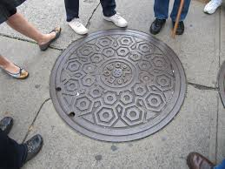



Water and Wastewater
Rate Study
Preliminary Results and Recommendations
February 12, 2022

Slide 2
City Staff Introductions and Overview

Slide 3
Meeting Guidelines/
Etiquette
If attending virtually, please mute upon joining the meeting
Questions will be answered during specific breaks
  Questions in writing can be submitted any time in the Q&A box available to participants who joined online
  To ask a question verbally use “raise a hand” to request to be unmuted
Time limit: 3 minutes
If there are additional questions please email those to: cityhall@cityofsolvang.com

Slide 4
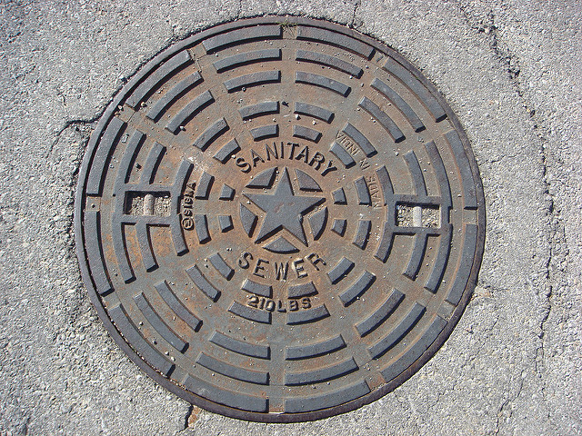

Water and Wastewater System Overview
Original system primarily installed in 1962
Average system age over 40 years
Provides service to over 2,000 accounts
Over 31 miles of pipelines
Operate 2 lift stations
Operate and maintain a wastewater treatment facility
Collect, convey, and treat 0.65 MGD per day
Original system primarily installed prior to 1940’s
Average system age over 80 years
Provides service to over 2,200 accounts
Over 40 miles of pipelines
Operate 3 water pump stations
Operate and maintain a water production and delivery facilities
Purchase, treat, and distribute 0.6-1.8 MGD per day

Slide 5
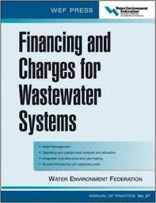

Provides sufficient revenue to operate and maintain City’s water and wastewater infrastructure
Develop equitable, proportional, and cost-based water and sewer rates
  Meet the requirements of Proposition 218
Develop the study using generally accepted methodologies
  Tailored to the City’s systems and customer characteristics
Reflect prudent financial planning criteria
  Adequate rate funding of capital projects
  Meet target reserve ending balances
  Maintain legally required debt service coverage
  ratios
Last water and wastewater rate adjustment was in 2016
Purpose of the Rate Study
5

Slide 6
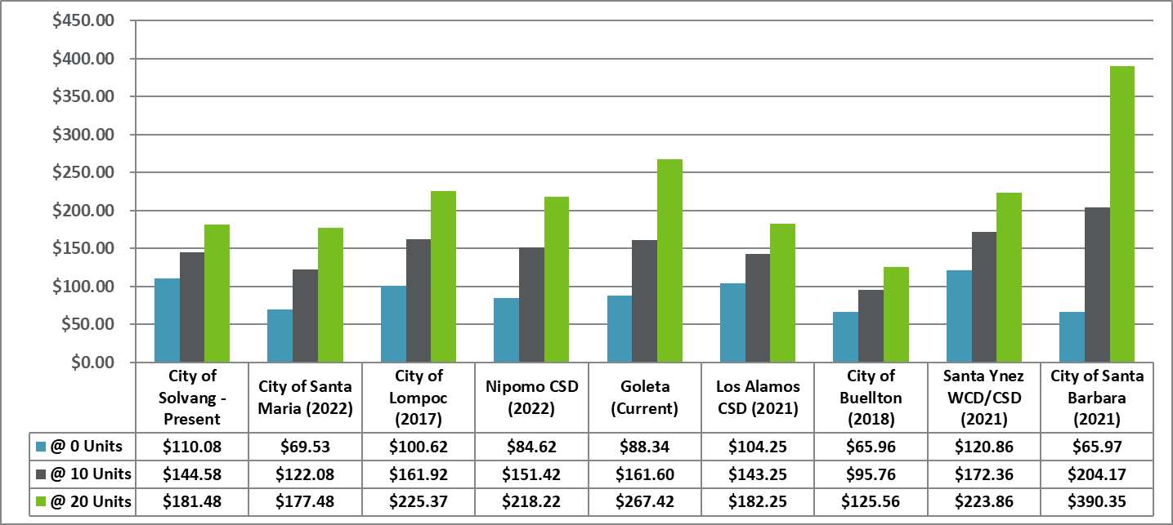
Combined Water/Sewer Bill Comparison

Slide 7
Overview of the Proposition 218
Provides the requirement for setting and implementing property related rates and fees
  California constitution Article XIII D
Requires a cost basis for establishing the level of the rates
  “Fees shall not exceed the reasonable cost of providing the service”
  “Fees shall not exceed the proportional cost of providing the service attributable to the parcel which it is imposed”
Requires a customer notification process and protest hearing
  Proposed rates are the maximum rates that can be charged for the specified time period
7

Slide 8
Establishing Cost-Based Water and Wastewater Rates
Revenue Requirement
Compares the revenue of the utility to the expenses to evaluate the level of overall rate revenues
Cost of Service
Proportionally distributed the revenue requirement between the various customer classes of service
Rate Design
Design rates for each class of service to meet the revenue needs of the utility, along with the cost of service proportional distribution of costs
8

Slide 9
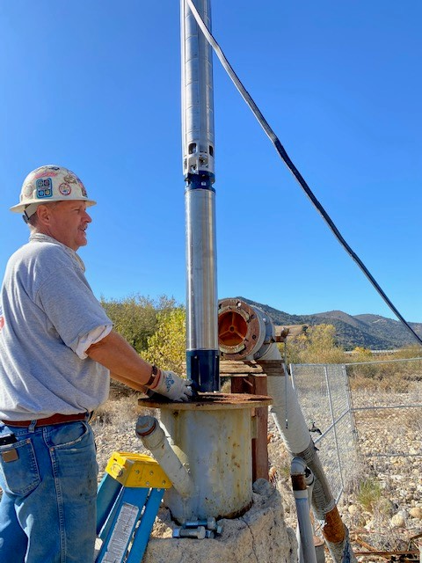
Overview of the Presentation
Present the preliminary results of the water and wastewater rate study
  Preliminary revenue requirement results
  Preliminary cost of service results
  Preliminary rate designs
Discuss study next steps and schedule
Gain input and feedback from the public
9

Slide 10

Revenue Requirement – Draft Results

Slide 11
Overview of the Revenue Requirements
Compares utility revenues to expenses
Determines the level of revenue (rate) adjustment necessary
Reviews a specific time period
Five-year rate schedule; ten-year financial plan
Utility is analyzed on a “stand-alone basis”
Utilizes the “cash basis” methodology
No transfer of funds from other City funds
Rates support each utility’s operations and capital
Generally accepted method for municipal utilities
Uses prudent financial planning criteria
Maintaining sufficient ending reserve balances
Attaining target debt service coverage (DSC) ratio

Slide 12
Revenue Requirement Key Assumptions
Developed a projection of water and wastewater rate revenues
  Based on current adopted rates and recent customer characteristics
O&M projections are based on the 2021/22 adopted budget
  Projected over the 10-year period using historical inflationary factors
Capital funding analysis is based on current capital
plans
  Includes long-term borrowing to fund capital needs
  Includes funding from annual rate funded capital
  and available reserves
Meet target financial planning metrics
  Target ending reserve levels (operating and capital
  funds)
  Maintain adequate debt service coverage ratios

Slide 13
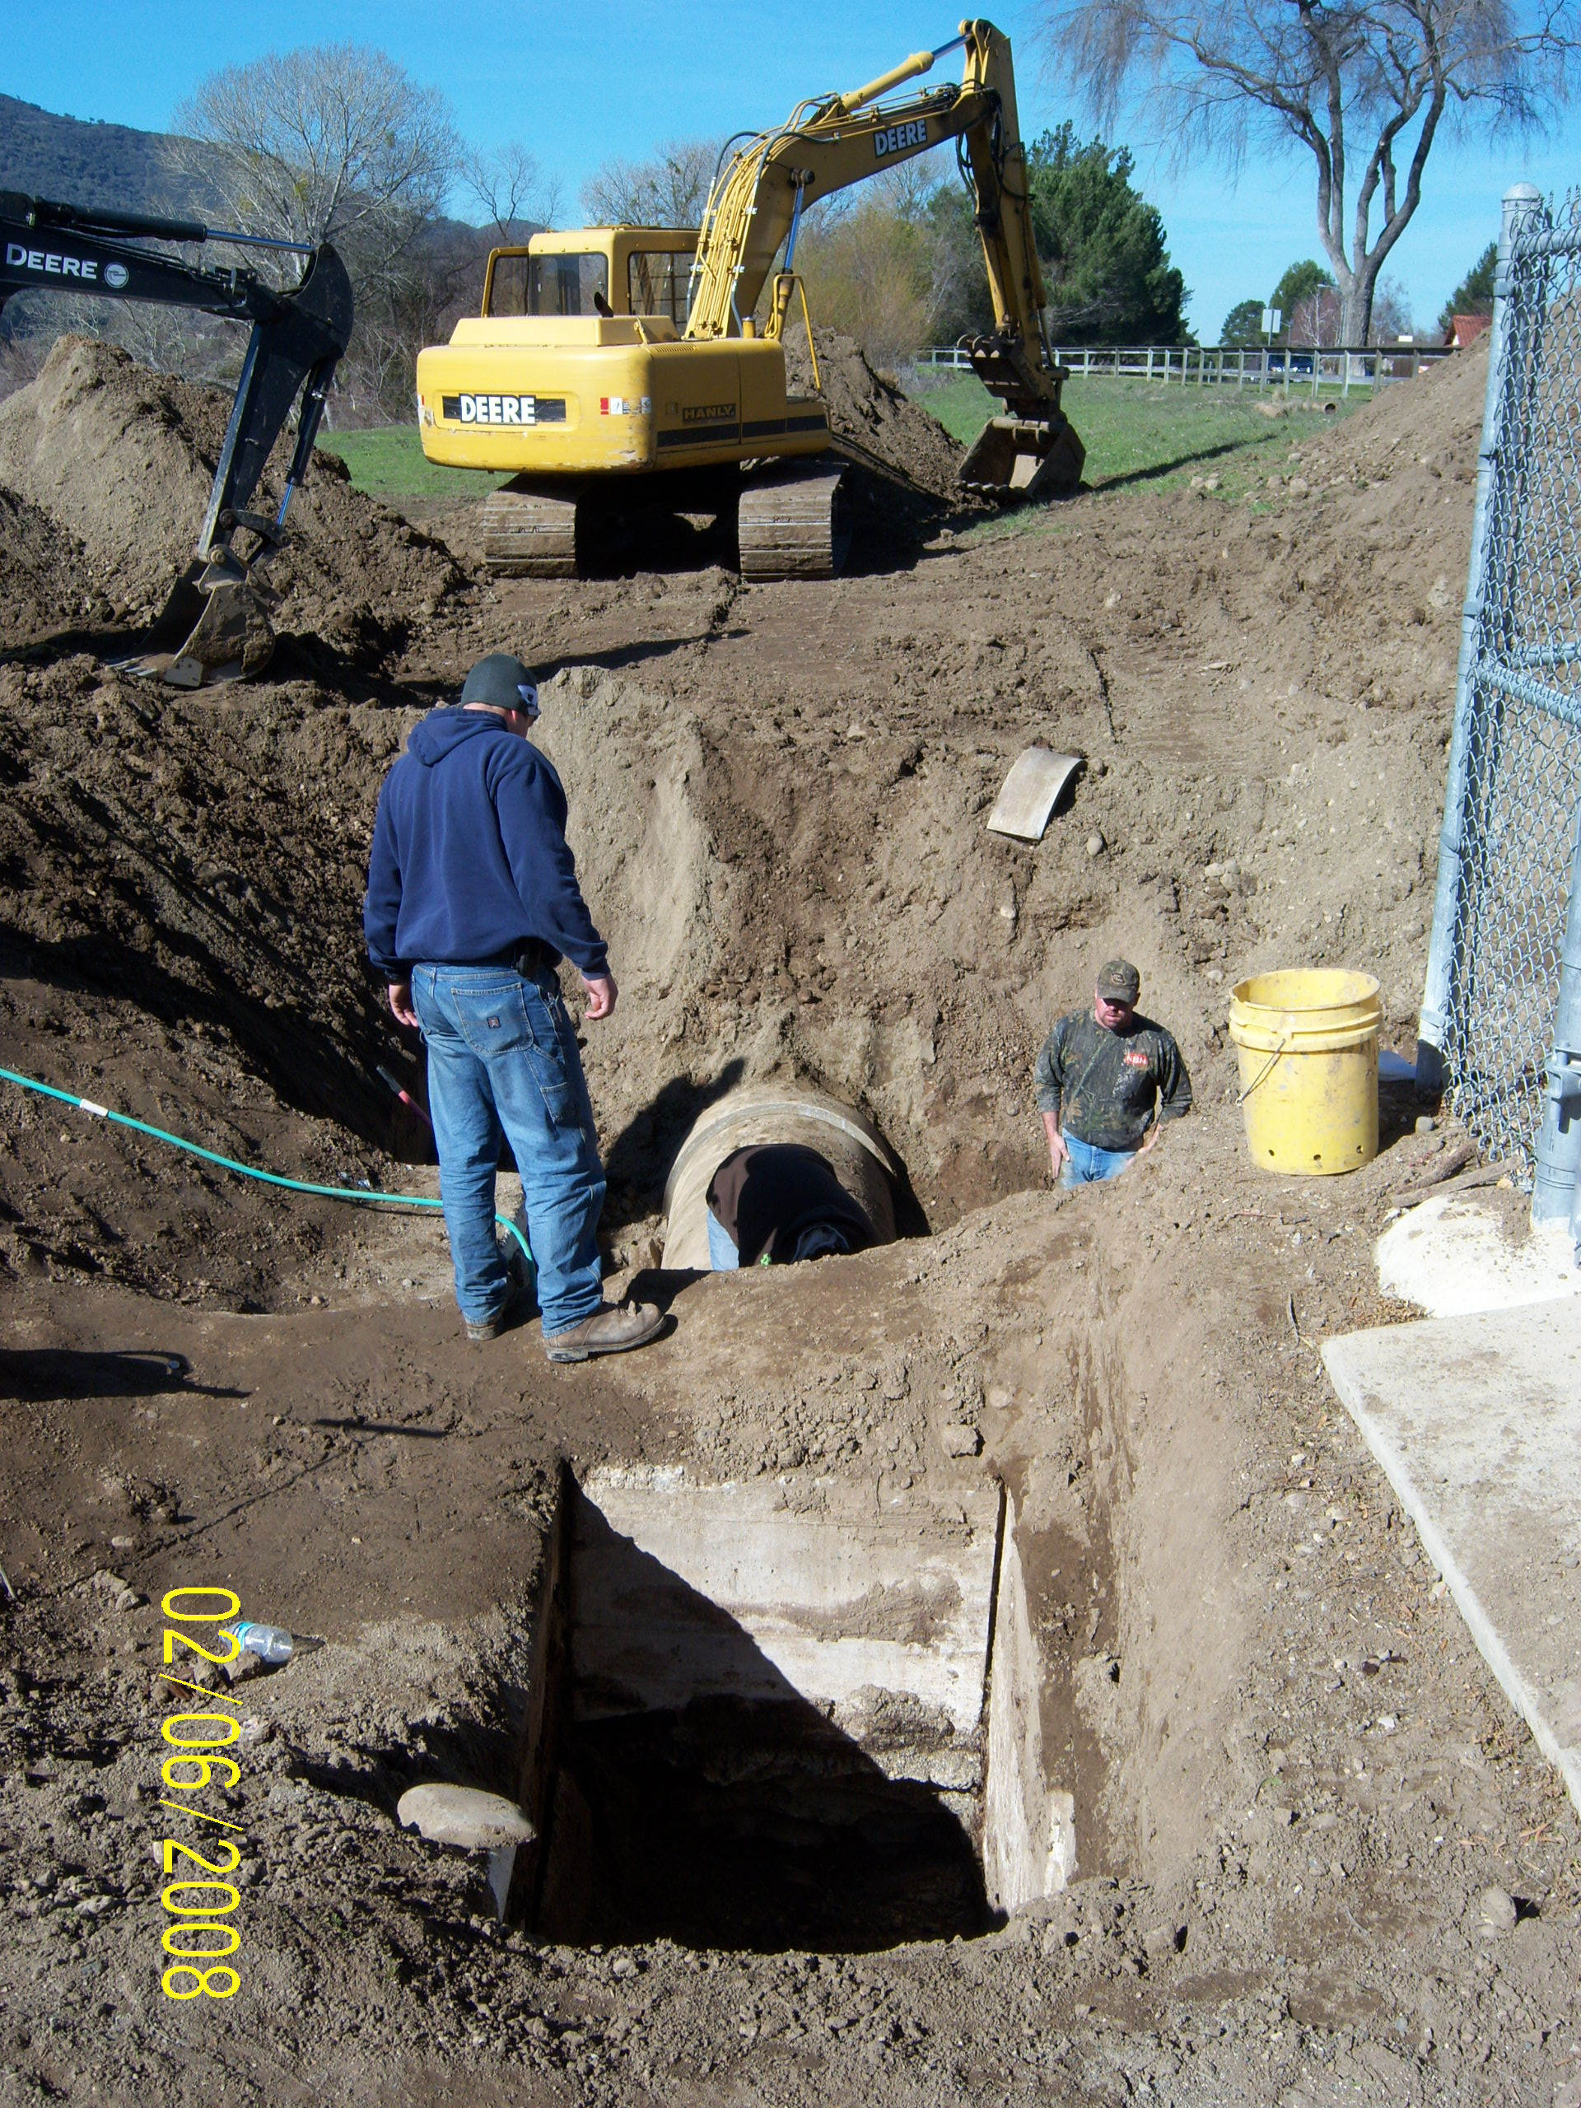
Overview of the Water Capital Improvement Needs
City has completed a review to identify infrastructure needs
  Renewal and replacements/expansion/regulatory required
  Safety/health/water loss
Investments in aging infrastructure and equipment are necessary to maintain service levels
  ~$12.6 million over the next 5 years
  ~$18.3 million over the next 10 years
Key improvements:
  Annual waterline replacement
  program
  Reservoir 1 expansion
  River wells project

Slide 14
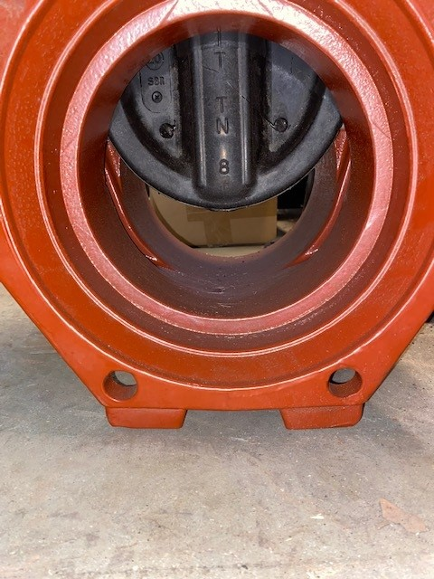
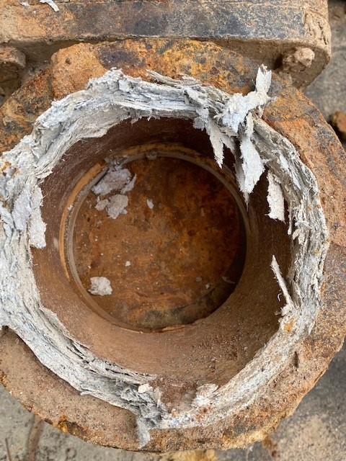
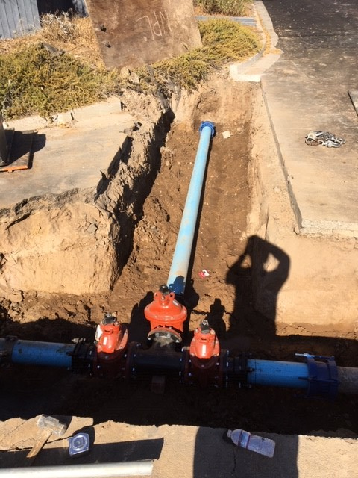
Recent Water Capital Improvements

Slide 15
Water Capital Funding Plan
Long-term borrowing for the river wells project and reservoir 1 expansion
15

Slide 16
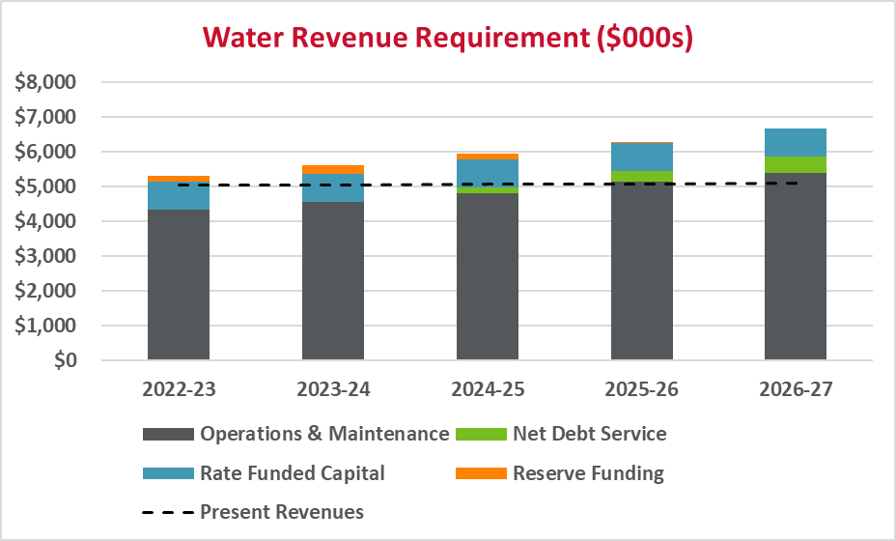
Summary of the Water Revenue Requirement
16

Slide 17
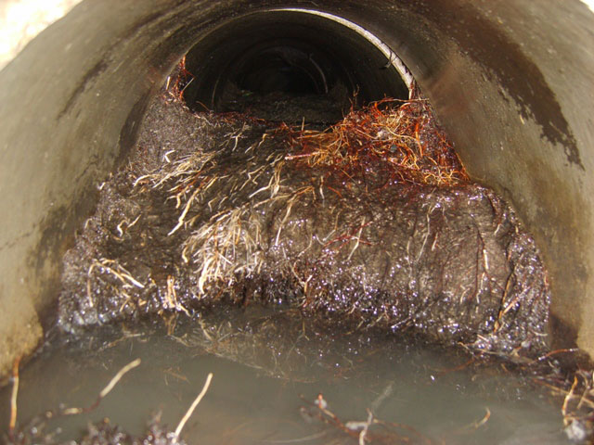
Overview of the Wastewater Capital Improvement Needs
City has completed a review to identify infrastructure needs
  Renewal and replacements/expansion/regulatory required
  Safety/health/inflow and infiltration
Investments in aging infrastructure and equipment are necessary to maintain service levels
  ~$21.1 million over the next 5 years
  ~$25.7 million over the next 10 years
Key improvements:
  Annual sewer line
  replacement program
  Lift station upgrades
  WWTP quality project
  Manhole rehabilitation

Slide 18
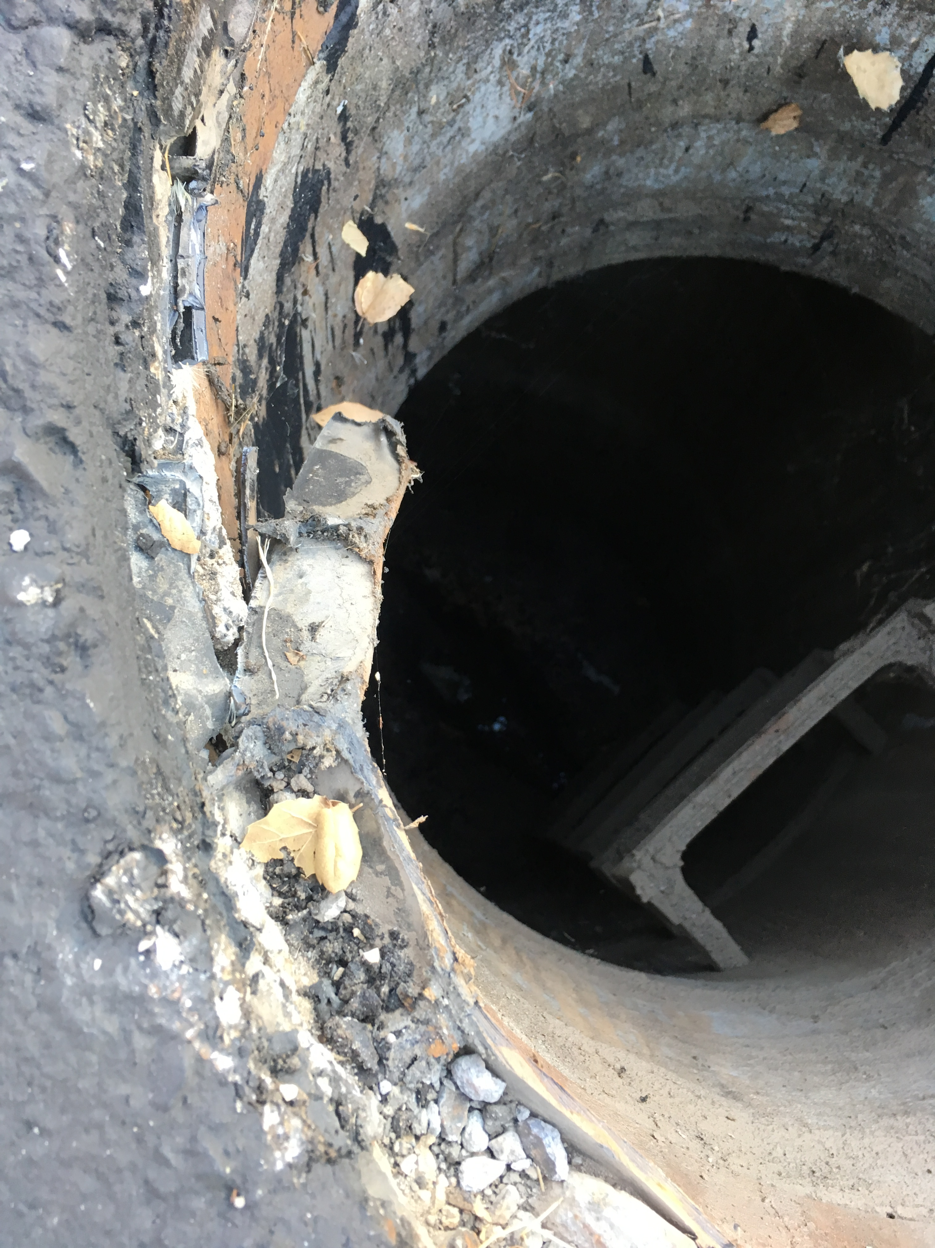
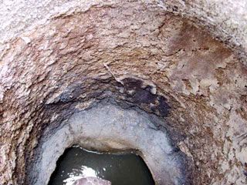
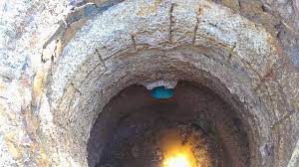
Recent Wastewater Capital Improvements

Slide 19
Wastewater Capital Funding Plan
Long-term borrowing for the WWTP Quality Project
19

Slide 20
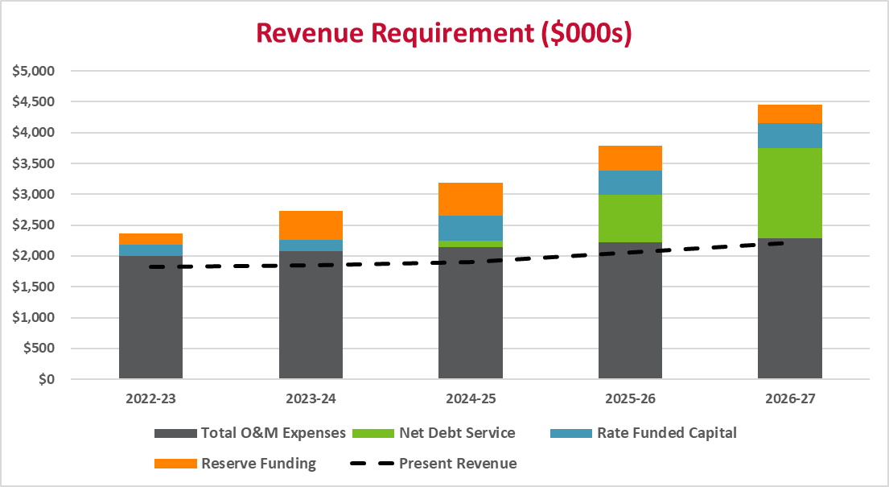
Summary of the Wastewater Revenue Requirement
20

Slide 21
Summary of the Water and Wastewater Revenue Requirement
Rate revenue adjustments are necessary
  Both water and wastewater utilities
Adjustments are driven by:
  Adequate funding for necessary capital improvements
  Inflationary increases in operating expenses
City is anticipating long-term borrowing for necessary capital improvements
  $6.25 million for water in FY 25 – FY 27
  $19 million for wastewater in FY 25 - FY 27
  Need to maintain strong financial metrics
  Debt service coverage ratios
  Prudent reserve fund balances

Slide 22

Cost of Service

Slide 23
Overview of the Cost of Service
What is cost of service?
Analysis to proportionally distribute the revenue requirement to the customer classes of service
Why cost of service
Avoids interclass subsidies
Revenues reflect costs
Objectives of Cost of Service
Determine if subsidies exist
Develop average unit costs
Meet the proportionality requirements of Proposition 218
23

Slide 24
Cost of Service Key Assumptions
Water Customer classes
  Single Family
  Multi-family
  Commercial
  Irrigation
Primary cost drivers
  Average consumption
  Peak consumption
  Customer (fixed) costs
Results provide the relationship between current revenues and current costs
Wastewater Customer classes
  Single Family
  Multi-family
  Commercial - Low
  Commercial - High
Primary cost drivers
  Total wastewater volumes
  Strength of wastewater
  Customer (fixed) costs
Results provide the relationship between current revenues and current costs

Slide 25
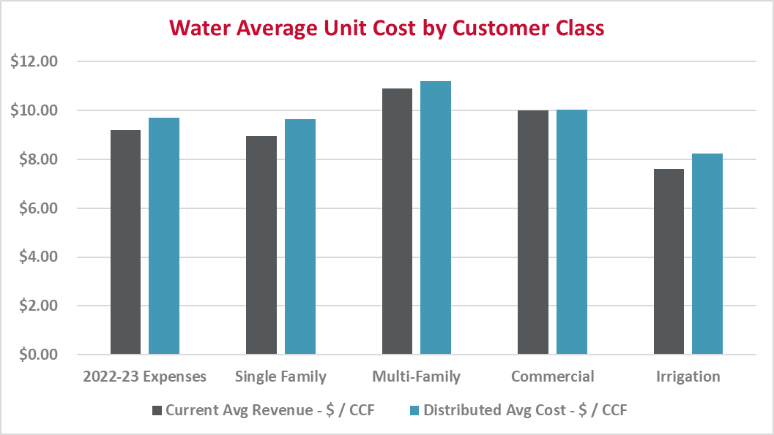
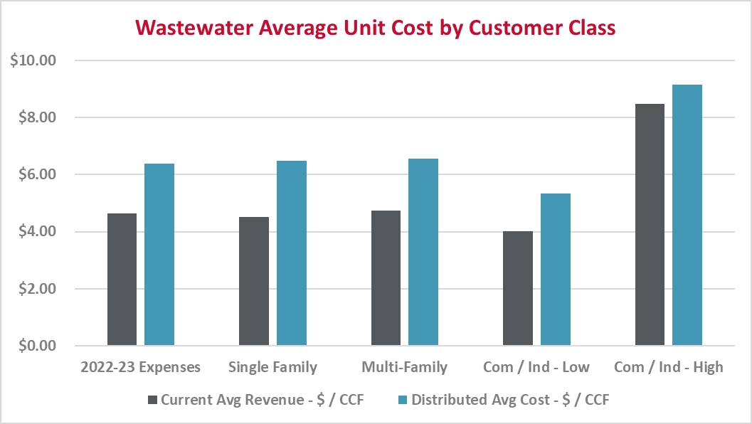
Preliminary FY 22-23 Cost of Service Summary
25

Slide 26
Summary of the Water and Wastewater Cost of Service
Minor cost differences do exist
  Both water and wastewater utilities
First comprehensive cost of service study in some time
  System and customer characteristics change over time
  Need to re-evaluate periodically to revise and reflect results
Recommend proposed water and wastewater rates reflect results of the revenue requirement and cost of service analyses
  Meet the intent and requirement of Proposition 218
First year of proposed rates is a “reset” year
  Subsequent years are “across the board” based on the overall revenue needs

Slide 27

Rate Design

Slide 28
Overview of the Rate Design
Reflect the findings of the revenue requirement and cost of service analyses
Meet the rate design goals and objectives of the City
Produce sufficient revenues to meet the target revenues of the utility, and each class of service
Are cost-based and proportional
28

Slide 29
Current Water Rate Structures
 | Present Rates
Fixed Charge
5/8" | $75.43
3/4" | 113.15
1" | 188.58
1 1/2" | 377.17
2" | 603.47
3" | 1,206.94
4" | 1,885.84
6" | 3,771.68
8” | 6,034.69
Consumption Charge
Single Family
0 – 16 ccf | $3.45
16 + ccf | 4.05
All Others | $3.75
Fixed Charge
  All customers - varies by service meter size
Consumption Charge
  Single Family – 2-tiered increase blocks
  All others (multi-family, commercial, irrigation) – uniform rate
  Evaluating three tier water rate structure for Single Family
29

Slide 30
Preliminary Proposed Water Rates – Fixed Charge
 | Present Rates | Proposed Rates FY 22-23 | Proposed Rates FY 23-24 | Proposed Rates FY 24-25 | Proposed Rates FY 25-26 | Proposed Rates FY 26-27
Fixed Charge - $/Month
5/8" | $75.43 | $75.60 | $79.76 | $84.15 | $88.78 | $93.66
3/4" | 113.15 | 113.41 | 119.65 | 126.23 | 133.17 | 140.49
1" | 188.58 | 189.01 | 199.41 | 210.38 | 221.95 | 234.16
1 1/2" | 377.17 | 378.02 | 398.81 | 420.74 | 443.88 | 468.29
2" | 603.47 | 604.83 | 638.10 | 673.20 | 710.23 | 749.29
3" | 1,206.94 | 1,209.66 | 1,276.19 | 1,346.38 | 1,420.43 | 1,498.55
4" | 1,885.84 | 1,890.09 | 1,994.04 | 2,103.71 | 2,219.41 | 2,341.48
6" | 3,771.68 | 3,780.18 | 3,988.09 | 4,207.43 | 4,438.84 | 4,682.98
8” | 6,034.69 | 6,048.29 | 6,380.95 | 6,731.90 | 7,102.15 | 7,492.77
30

Slide 31
Preliminary Proposed Water Rates – Consumption Charge
 | Present Rates | Proposed Rates FY 22-23 | Proposed Rates FY 23-24 | Proposed Rates FY 24-25 | Proposed Rates FY 25-26 | Proposed Rates FY 26-27
Consumption Charge - $/CCF
Single Family
0 – 16 ccf | $3.45 | --- | --- | --- | --- | ---
16 + ccf | 4.05 | --- | --- | --- | --- | ---
0 – 15 ccf | --- | $4.00 | $4.22 | $4.45 | $4.69 | $4.95
15 – 35 ccf | --- | 4.60 | 4.85 | 5.12 | 5.40 | 5.70
35 + ccf | --- | 5.40 | 5.70 | 6.01 | 6.34 | 6.69
Multi-Family – All Consumption | $3.75 | $4.08 | $4.30 | $4.54 | $4.79 | $5.05
Commercial – All Consumption | 3.75 | 4.11 | 4.34 | 4.58 | 4.83 | 5.10
Irrigation – All Consumption | 3.75 | 4.40 | 4.64 | 4.90 | 5.17 | 5.45
31

Slide 32
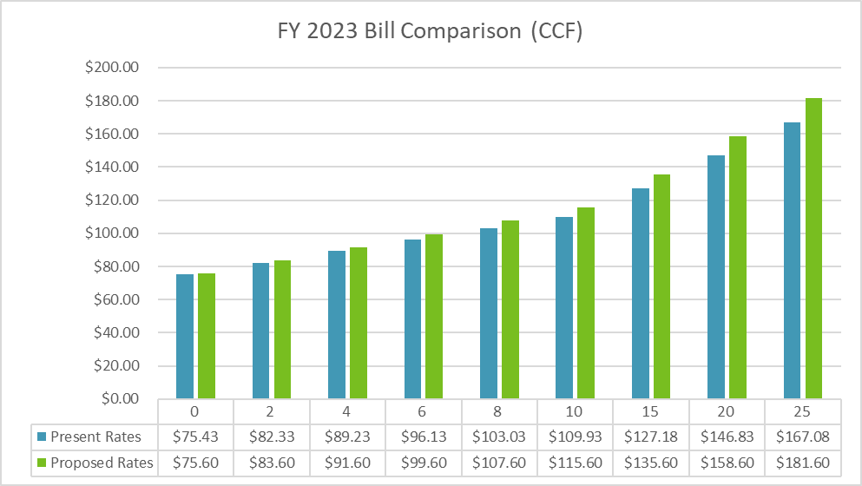
Single Family Water Bill Comparison
32

Slide 33
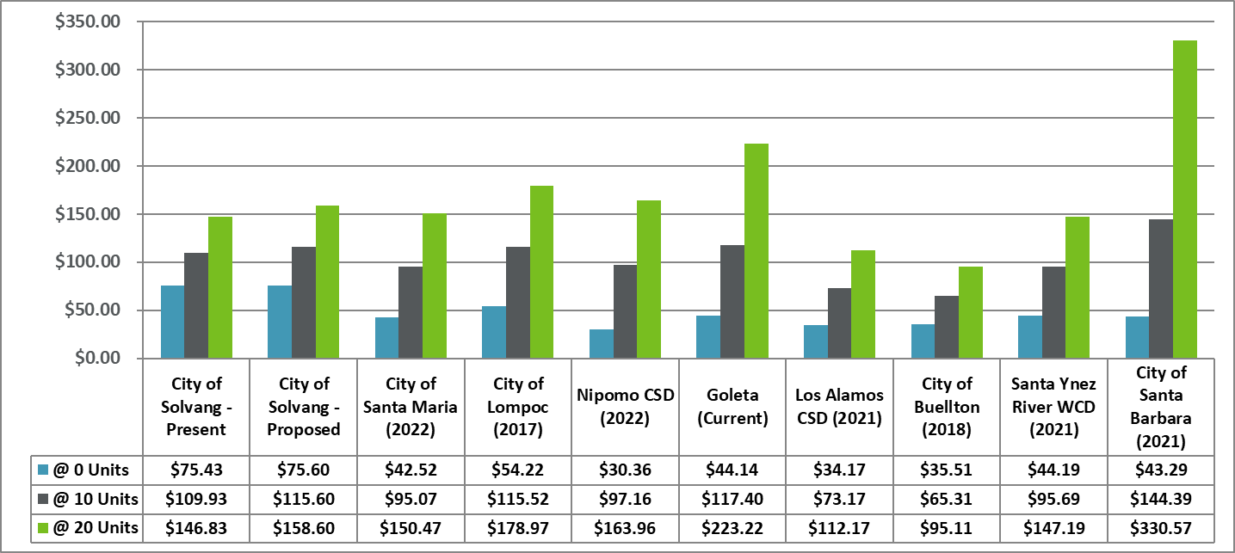
Local and Regional Residential Water Bill Comparison
33

Slide 34
Current Wastewater Rate Structure
Fixed Charge
  All customers – flat rate
Volumetric Charge
  Single Family and Multi-Family – none
  Commercial & Industrial – uniform rate
Recommend maintaining current rate structure
  Only the level of the rates will be revised
 | Present Rates
Fixed Charge
All Customers | $34.65
Volumetric Charge | $ / CCF
Com & Ind | $2.85
Com & Ind – High | 7.42
34

Slide 35
Preliminary Proposed Wastewater Rates
 | Present Rates | Proposed Rates FY 22-23 | Proposed Rates FY 23-24 | Proposed Rates FY 24-25 | Proposed Rates FY 25-26 | Proposed Rates FY 26-27
Fixed Charge - $/Month
Single Family | $34.65 | $49.88 | $58.61 | $68.87 | $79.54 | $91.87
Multi-Family | 34.65 | 47.90 | 56.28 | 66.13 | 76.38 | 88.22
Com & Ind | 34.65 | 39.43 | 46.33 | 54.44 | 62.88 | 72.63
Com & Ind – High | 34.65 | 42.14 | 49.51 | 58.17 | 67.19 | 77.60
Volumetric Charge - $/CCF
Single Family | $0.00 | $0.00 | $0.00 | $0.00 | $0.00 | $0.00
Multi-Family | 0.00 | 0.00 | 0.00 | 0.00 | 0.00 | 0.00
Com & Ind | 2.85 | 4.06 | 4.77 | 5.60 | 6.47 | 7.47
Com & Ind – High | 7.42 | 7.89 | 9.27 | 10.89 | 12.58 | 14.53
35

Slide 36
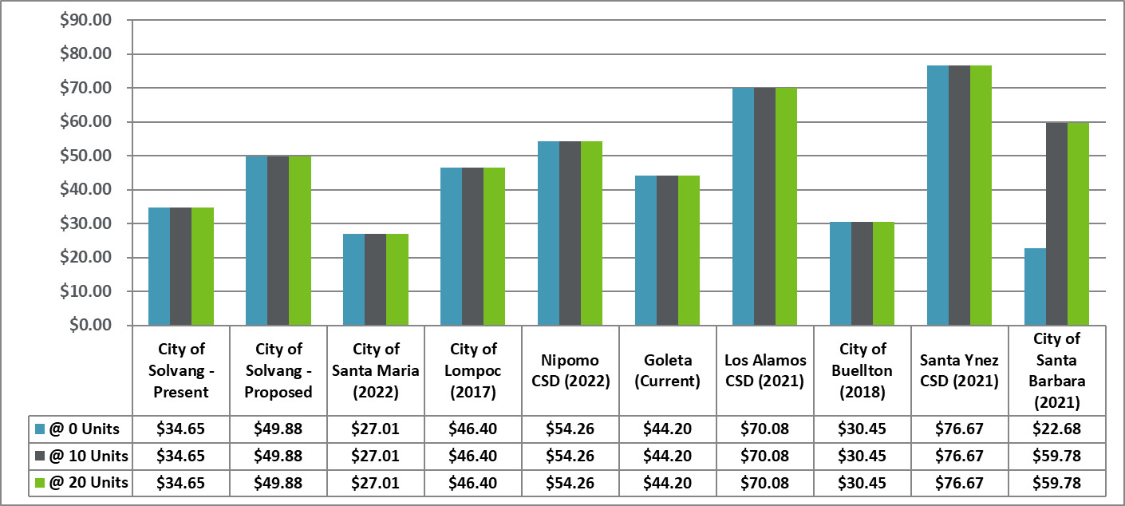
Local and Regional Residential Sewer Bill Comparison
36

Slide 37
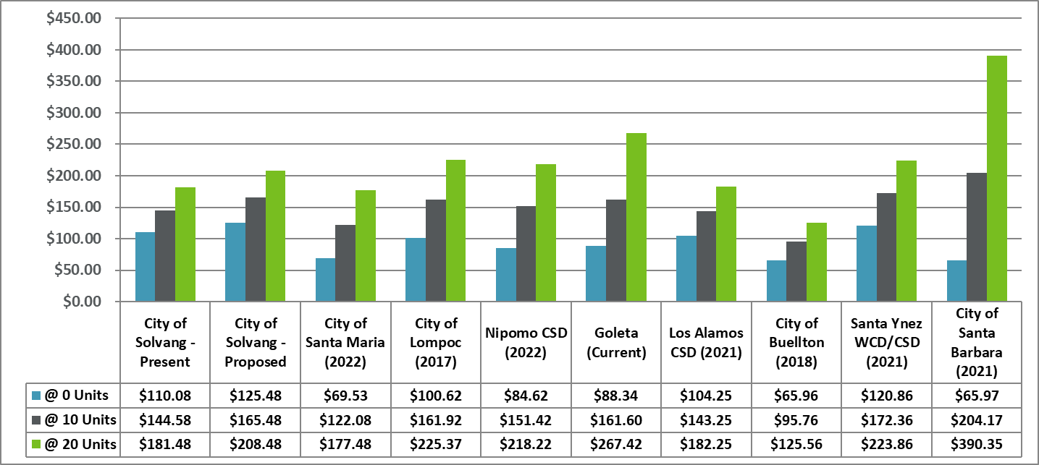
Local and Regional Residential Combined Bill Comparison
37

Slide 38

Next Steps and Schedule

Slide 39
Next Steps Schedule
Gain public feedback
Present final recommendations and public feedback to the Council
Finalize water and sewer rate technical analyses
Complete connection charge analysis
Present findings and proposed rates and charges
March 2022: Council review final study recommendations and set Prop. 218 hearing
June 2022:Prop 218 hearing and rate adoption
July 1, 2022: rate implementation
39
39

Slide 40

Thank you for your input!
40

